Slide 1
Quiz/challenge
This function is not yet working like it should, and it is not linked to the quiz – challenge buttons in the user’s profile
Admin can create quiz or challenge, which are basically a set of questions with multiple choice answers
We can set them to be sent automatically, like when a user ranks up, or manually if we would like to send a challenge for all users or intermediate users…

Slide 2
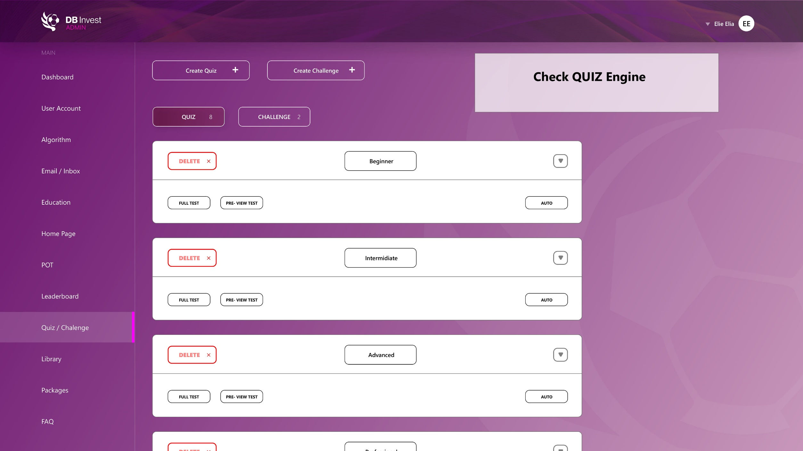

Slide 3
